Slide 1


Database Design - RDBMS
mintesnot

Slide 2

What is RDBMS?
SQL Databases
SQL DDL Statements
SQL DML Statements
SQL DQL Statements
SQL Constraints
SQL Primary Keys
SQL Foreign Keys
SQL Composite Keys
SQL Alternative Keys
Data Integrity
SQL Indexes

Slide 3

What is RDBMS?
RDBMS stands for Relational Database Management System. RDBMS is the basis for SQL, and for all modern database systems like MS SQL Server, IBM DB2, Oracle, MySQL, and Microsoft Access.
A Relational Database stores data in tables that are related to one another.
Instead of storing student information multiple times, we store it once and reference it when needed.
Key Characteristics
Data stored in rows and columns
Tables can be connected through relationships
Uses SQL (Structured Query Language)
Reduces duplicate data

Slide 4
























SQL Databases

Slide 5

Popular SQL Databases
There are several types of SQL-based relational databases, each with its own features and uses.
MySQL: Free and open-source, commonly used for websites and small to medium applications.
PostgreSQL: Advanced open-source database that supports complex queries and additional features.
Oracle Database: A commercial database often used by large enterprises, known for reliability and advanced tools.
Microsoft SQL Server: Widely used in corporate environments, integrates well with other Microsoft products.
SQLite: A lightweight database embedded directly into applications, often used in mobile or desktop apps.

Slide 6
Terminology
Term | Meaning
Table | Collection of related data
Row | Single Record
Column | Data field
Record | One row in a table
Field | Individual piece of data

Slide 7
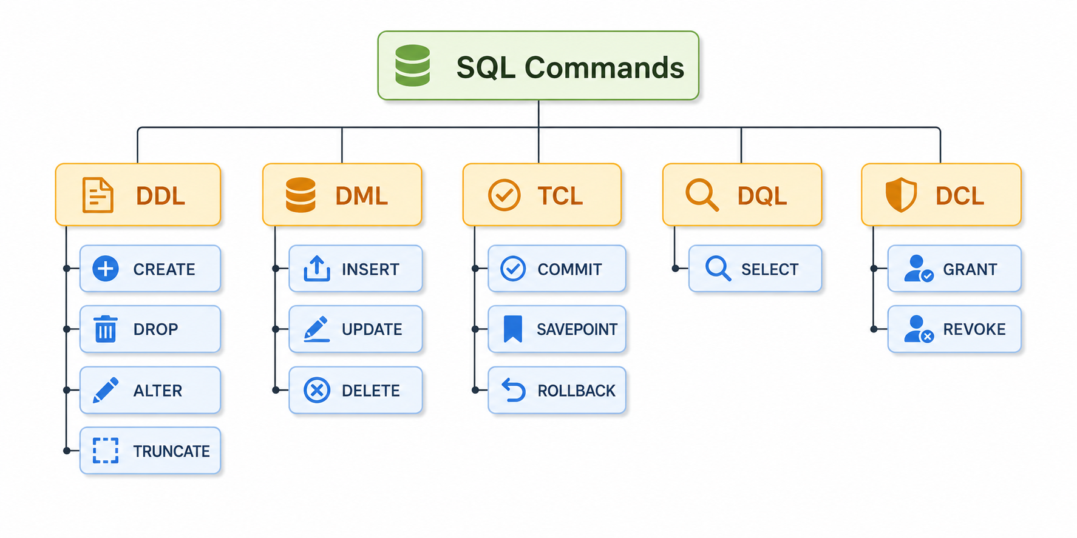

Slide 8
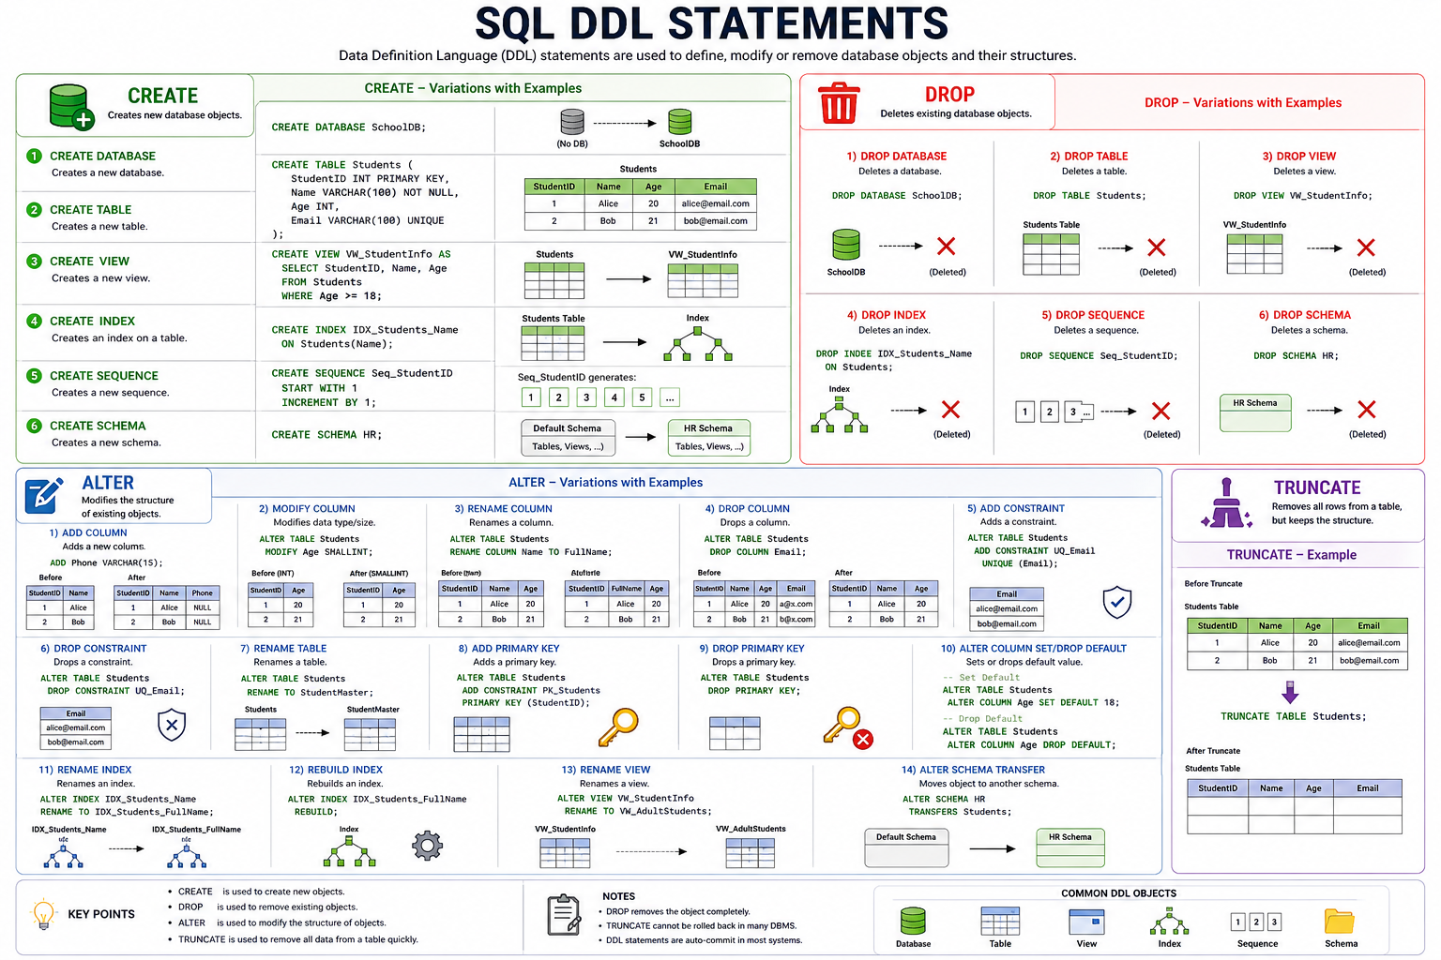

Slide 9
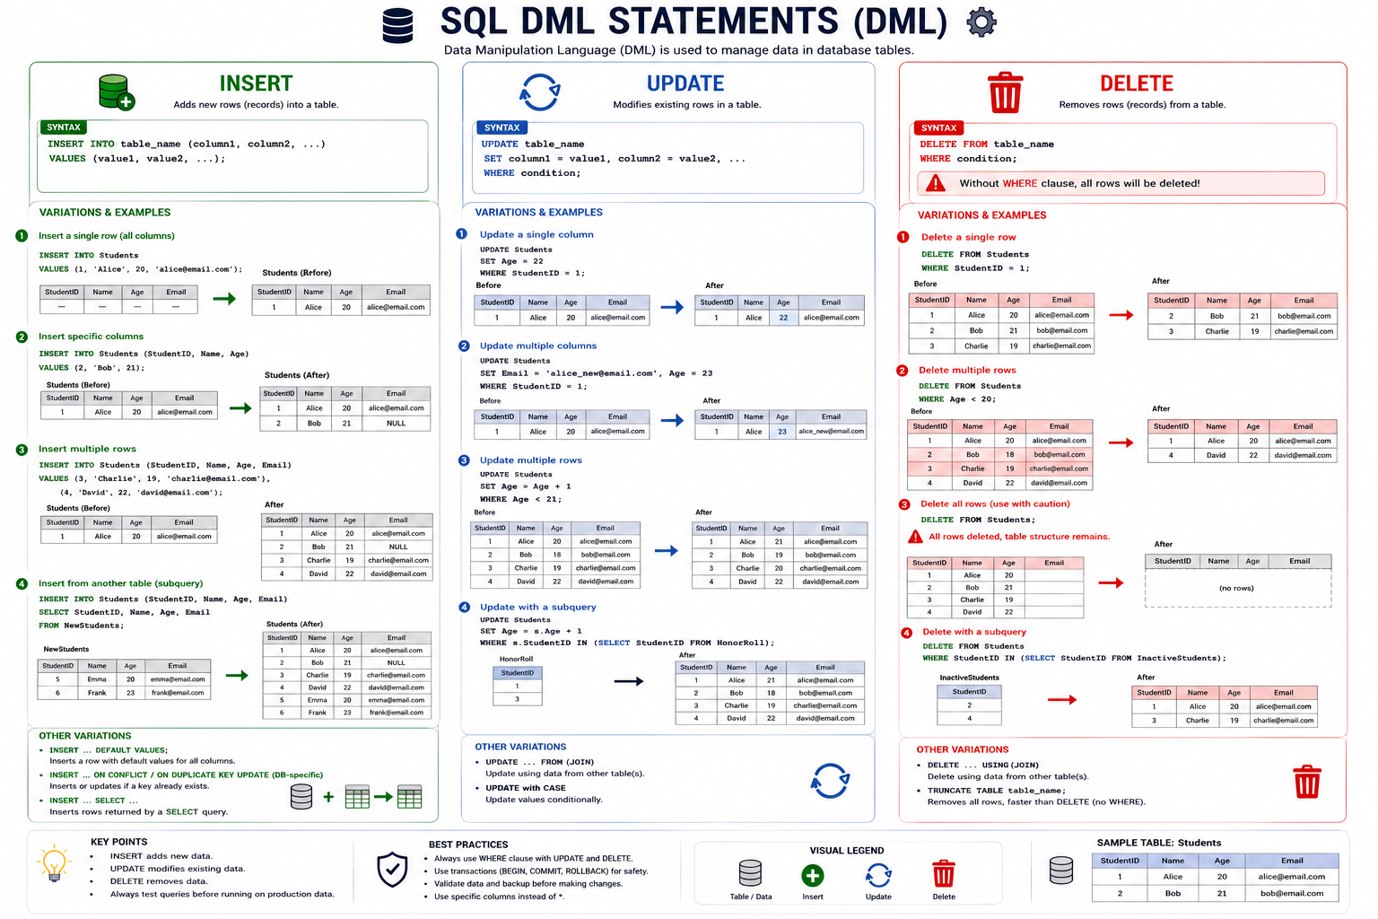

Slide 10
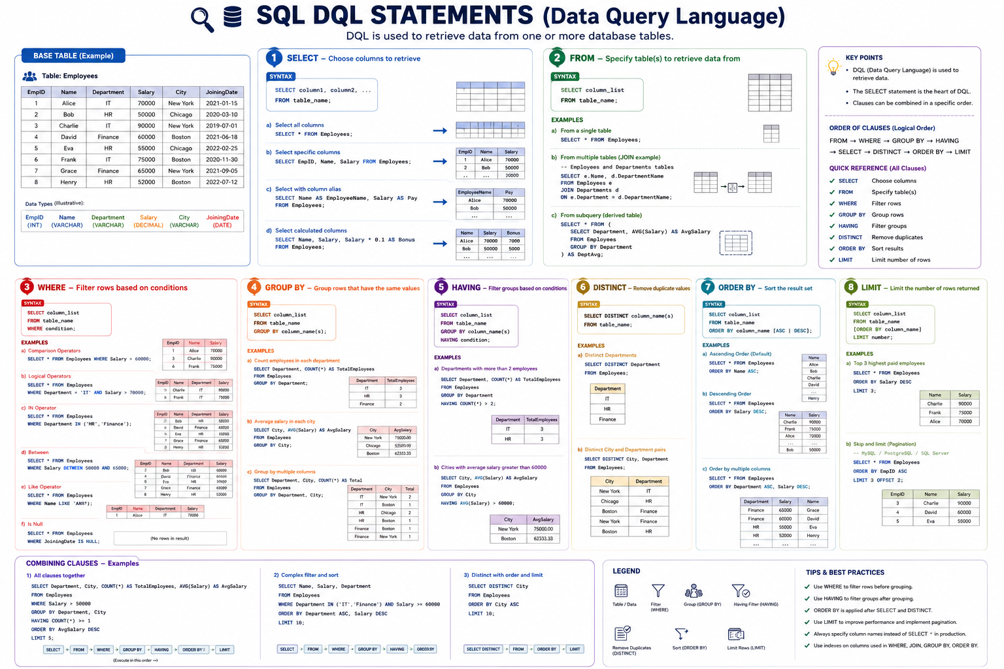

Slide 11
Data Types
A Data Type specifies the kind of data that can be stored in a table column.
Choosing the correct data type improves storage efficiency, data integrity, and query performance.
While creating a database table in a database, we need to specify following two attributes to define a table column:
Name of the column
Data type of the column
Why Are Data Types Important?
✅ Ensure data accuracy ✅ Reduce storage usage ✅ Improve database performance ✅ Prevent invalid data entry
CREATE TABLE table_name(column1 datatype, column2 datatype....)

Slide 12
Data Types (in PostgreSQL)
Category | Data Types | Example
Numeric Types | SMALLINT, INTEGER (INT), BIGINT, DECIMAL, NUMERIC, REAL, DOUBLE PRECISION, SMALLSERIAL, SERIAL, BIGSERIAL | 12345, 123.45, 3.14159
Character/String Types | CHAR(n), VARCHAR(n), TEXT | “John”
Boolean Type | BOOLEAN | TRUE, FALSE
Date and Time Types | DATE, TIME, TIME WITH TIME ZONE, TIMESTAMP, TIMESTAMP WITH TIME ZONE, INTERVAL | '2026-06-20', '14:30:00'
Monetary Type | MONEY | $1,500.75
Binary Data Type | BYTEA | '\xDEADBEEF'
UUID Type | UUID | '550e8400-e29b-41d4-a716-446655440000'
JSON Types | JSON, JSONB | '{"name":"John"}'
XML Type | XML | '<employee><name>John</name></employee>'

Slide 13
…
Category | Data Types | Example
Array Types | INTEGER[], TEXT[], VARCHAR[] | '{1,2,3,4}', '{"Apple","Banana"}'
Enumerated Types | ENUM | 'Pending', 'Approved'
Composite Types | User-defined Composite Types | '(John,25,Developer)'
Range Types | INT4RANGE, INT8RANGE, NUMRANGE, TSRANGE, TSTZRANGE, DATERANGE | '[1,10)', '[2026-01-01,2026-12-31]'
Geometric Types | POINT, LINE, LSEG, BOX, PATH, POLYGON, CIRCLE | '(10,20)', '((0,0),(10,10))'
Network Address Types | CIDR, INET, MACADDR, MACADDR8 | '192.168.1.100', '08:00:2b:01:02:03'
Bit String Types | BIT, BIT VARYING | B'10101010'
Text Search Types | TSVECTOR, TSQUERY | 'postgresql & database'
Object Identifier Types | OID, REGPROC, REGCLASS, REGTYPE | 16384, 'employees'

Slide 14
SQL Constraints
SQL Constraints are rules applied to table columns to enforce data integrity, accuracy, and consistency in a database.
They prevent invalid data from being inserted, updated, or deleted and help maintain reliable relationships between tables.
SQL Constraints act as data validation rules that ensure only accurate and meaningful data is stored in the database.
Benefits of Constraints
It improves data quality and consistency.
Prevent invalid or duplicate data.
Enforce business rules automatically.
Main relationships between tables.
Enhance database reliability and integrity.

Slide 15
…
Constraint | Description | Example
NOT NULL | Ensures a column cannot contain NULL values. | A customer’s name must always be provided.
UNIQUE | Ensures all values in a column are different | No two users can have the same email address.
PRIMARY KEY | Uniquely identifies each record in a table. Combines UNIQUE and NOT NULL. | StudentID uniquely identifies each student.
FOREIGN KEY | Maintains referential integrity between tables. | DepartmentID in Employee table references Department table.
CHECK | Restricts values based on a condition | Age must be greater than 18.
DEFAULT | Assigns a default value if none is provided. | Status defaults to ‘Active’.

Slide 16
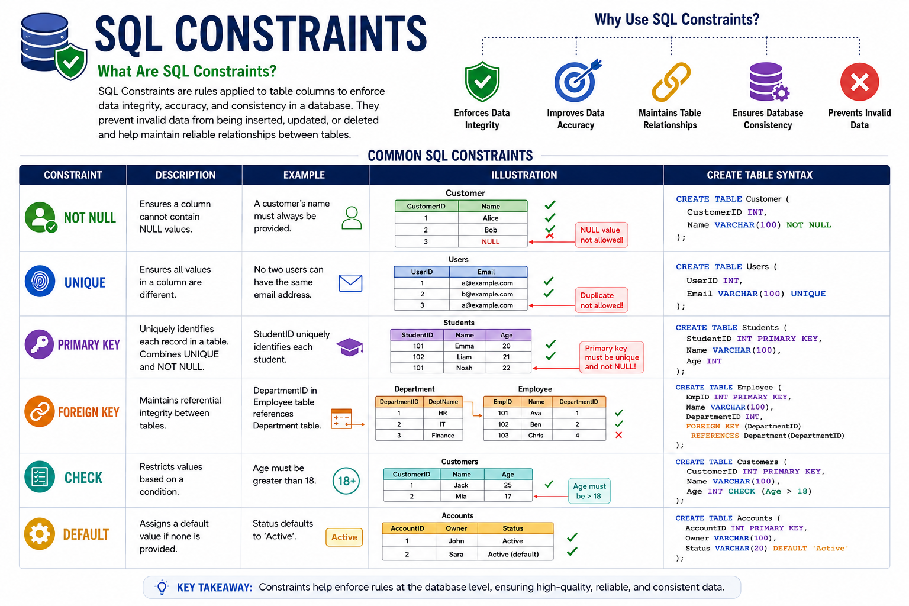

Slide 17

SQL Primary Key (PK)
A Primary Key is a column (or set of columns) that uniquely identifies every second in a table.
It ensures each row can be uniquely identifies every record in a table.
A table can have only one Primary Key, and its values must always be unique and NOT NULL.
Every table should have a Primary Key to ensure that each row can be uniquely accessed.
Syntax
CREATE TABLE table_name ( column_name datatype PRIMARY KEY );

Slide 18

SQL Unique Key (UK)
A Unique Key ensures that all values in a column are unique.
Unlike a Primary Key, a table can have multiple Unique Keys.
It prevents duplicate values.
Can contain NULL values (database-dependent).
Can be referenced by a Foreign Key.
Syntax
CREATE TABLE table_name ( column_name datatype UNIQUE );

Slide 19

SQL Foreign Key (FK)
A Foreign Key is a column that references the Primary Key (or Unique Key) of another table.
It creates a relationship between tables and ensures referential integrity.
It links two table together.
It maintains data consistency.
Prevents invalid references.
It creates Parent-Child relationships.
Syntax
CREATE TABLE child_table (
column_name datatype,
FOREIGN KEY (column_name)
REFERENCES parent_table(parent_column)
);

Slide 20

SQL Composite Key
A Composite Key is a key made up of two or more columns that together uniquely identify a record.
It is used when a single column is insufficient to guarantee uniqueness.
It commonly used in junction (bridge) tables.
Supports many-to-many relationships.
Syntax
CREATE TABLE table_name (
column1 datatype,
column2 datatype,
PRIMARY KEY (column1, column2)
);

Slide 21

SQL Alternate Key
An Alternate Key is a candidate key that was not selected as the Primary Key but can still uniquely identify a record.
In practice, Alternate Keys are usually implemented using UNIQUE constraints.
Multiple Alternate keys can exist.
Helps enforce additional uniqueness rules.
Syntax
CREATE TABLE table_name ( primary_column datatype PRIMARY KEY, alternate_column datatype UNIQUE );

Slide 22
Summary of SQL Keys
Key Type | Unique | Null Allowed | Count per Table | Purpose
🔑 Primary Key | ✅ | ❌ | One | Main identifier
🔒 Unique Key | ✅ | Usually Yes | Multiple | Enforce uniqueness
🔗 Foreign Key | ❌ | Yes | Multiple | Create relationships
🧩 Composite Key | ✅ (Combination) | Depends | One PK/FK combination | Multi-column identification
⭐ Alternate Key | ✅ | Usually Yes | Multiple | Alternative unique identifier

Slide 23
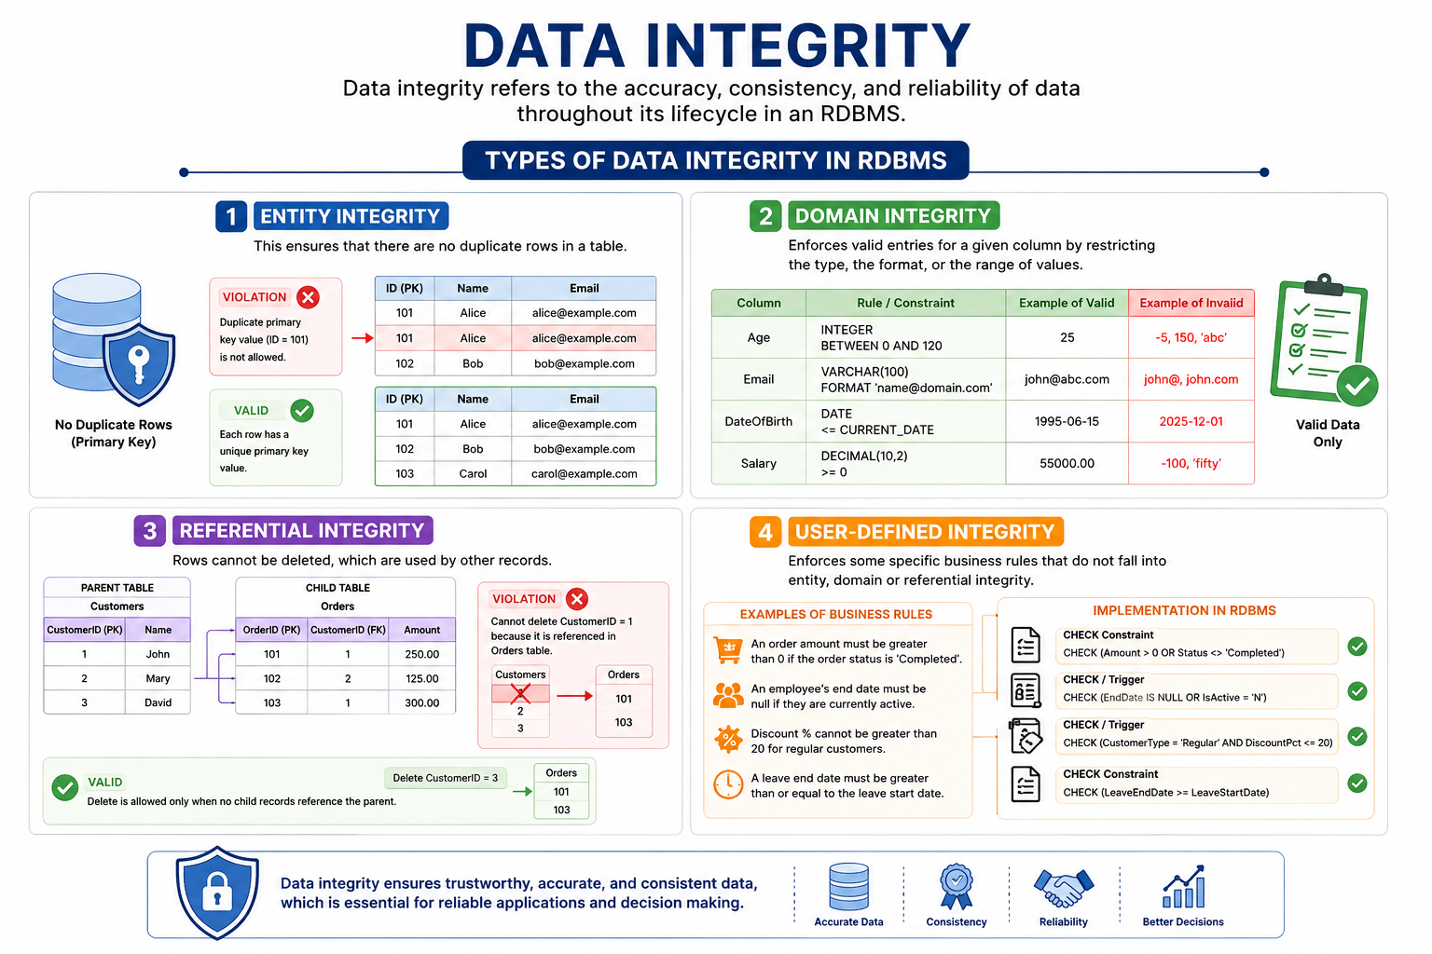

Data Integrity
Entity Integrity – This ensures that there are no duplicate rows in a table.
Domain Integrity – Enforces valid entries for a given column by restricting the type, the format, or the range of values.
Referential Integrity – Rows cannot be deleted, which are used by other records.
User-Defined Integrity – Enforces some specific business rules that do not fall into entity, domain or referential integrity.

Slide 24
SQL Aliases
An alias is created with the AS keyword, and is often used to make a column name more readable.
An alias only exists for the duration of that query.
Syntax
Alias for column:
SELECT column_name AS alias_name FROM table_name;
Alias for table:
SELECT column_name(s) FROM table_name AS alias_name;

Slide 25

SQL SELECT INTO Statement
The SELECT INTO statement is used to create a new table and fill it with data from an existing table.
The SELECT INTO statement is useful for creating backups or for creating a temporary table for analysis.
Note: The new table will be created with the same column names and data types as defined in the source table. However, primary keys, indexes, or NOT NULL constraints are not automatically transferred.
Copy entire table into a new table
Copy only some columns into a new table
SELECT * INTO newtable [IN external_db] FROM sourcetable WHERE condition;
SELECT column1, column2, column3, ... INTO newtable [IN external_db] FROM sourcetable WHERE condition;

Slide 26
SQL INSERT INTO Statement
The INSERT INTO SELECT statement is used to copy data from an existing table and insert it into another existing table.
The INSERT INTO SELECT statement requires that the data types in source and target tables match.
If you omit the column names, the number and order of columns in the source and target tables must be exactly the same.
Note: The existing records in the target table are unaffected.
Copy all columns from on table to another table
Copy only some columns from one table to another table
INSERT INTO target_table SELECT * FROM source_table WHERE condition;
INSERT INTO target_table (column1, column2, column3, ...) SELECT column1, column2, column3, ... FROM source_table WHERE condition;

Slide 27
SQL CASE Expression
The CASE expression is used to define different results based on specified conditions in an SQL statement.
The CASE expression goes through the conditions and stops at the first match (like an if-then-else statement). So, once a condition is true, it will stop processing and return the result. If no conditions are true, it returns the value in the ELSE clause. If there is no ELSE clause and no conditions are true, it returns NULL.
CASE WHEN condition1 THEN result1 WHEN condition2 THEN result2 WHEN conditionN THEN resultN ELSE default_result END;

Slide 28
